Slide 1

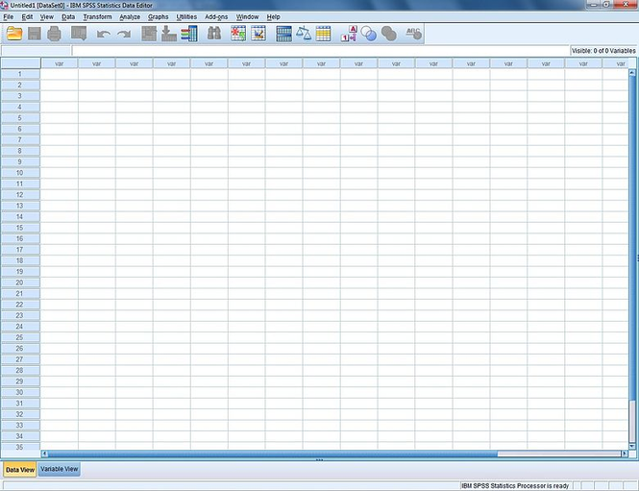

Slide 2

An Introduction to SPSS
Software Application

Slide 3
Assessment
Attendance | 5% x 3
Assignments | 20% x 2
Participation | 15%
Quiz | 30%
Total | 100%

Slide 4
01.
What SPSS Is
02.
Why to Use SPSS
03.
Basic Concepts
04.
Getting Started

Slide 5
01
PART ONE
What SPSS Is

Slide 6

SPSS
The Statistical Package for the Social Sciences created by IBM, the most widely used and comprehensive statistical programs.

Slide 7
02
PART TWO
Why to Use SPSS

Slide 8


Whose fans have a better aesthetic taste?
How would you carry out a study to answer the question?

Slide 9
Why to Use SPSS
PART 2
Sampling
Population
Sample
A sample is made up of the cases chosen into the research; it is just a small part of the whole population.
Is it representative enough?

Slide 10

SPSS is run to analyze the data collected to test whether the findings can be generalized.

Slide 11
03
PART THREE
Basic Concepts in Statistics

Slide 12
Statistical Concepts
PART 3
Types of variables
The mean, mode & median
Variable
Normal distribution
Central tendency
Dispersion
Normal vs. skewed distribution
Standard deviation

Slide 13
Statistical Concepts
PART 3
Variable
Variables are things that we measure, control, or manipulate in research.
Examples of variables: gender, SES, age, years of residence, temperature, test scores, etc.
Aims of research: to find out relationships between variables

Slide 14
Statistical Concepts
PART 3
Variable
Independent variable
A variable thought to be the cause of an effect
Dependent variable
A variable thought to be affected by changes in an independent variable

Slide 15
Statistical Concepts
PART 3
gender & narcissism?
Do girls and boys have different degrees of narcissism?
What is the dependent variable?
What is the independent variable?

Slide 16
Statistical Concepts
PART 3
Levels of Measurement
Different types of variables
Different ways to measure those variables
Different statistical tests can be applied to the analysis of these variables

Slide 17
Statistical Concepts
PART 3
Levels of Measurement
Categorical variable:
Binary variable: e.g. dead or alive.
Nominal variable: e.g. whether someone is an omnivore, vegetarian, or fruitarian.
Ordinal variable: e.g. whether people got a fail, a pass, a merit or a distinction in their exam.
Interval variable: e.g. the difference between 6 and 8 is equivalent to the difference between 13 and 15.

Slide 18
Statistical Concepts
PART 3
Precision of Measurement
scale | Rank order | Equal distance
nominal | - | -
ordinal | + | -
interval | + | +

Slide 19
Statistical Concepts
PART 3
Exercise
What is the level of measurement of the following variables?
The number of downloads of different bands’ songs on iTunes.
The names of the bands that were downloaded.
The position in the iTunes download chart.
The money earned by the bands from the downloads.

Slide 20
Statistical Concepts
PART 3
Exercise
What is the level of measurement of the following variables?
The phone numbers that the bands obtained because of their fame.
The gender of the people giving the bands their phone numbers.
The instruments played by the band members.
The time they had spent learning to play their instruments.

Slide 21
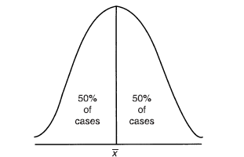
Statistical Concepts
PART 3
Normal distribution: a bell-shaped curve

Slide 22
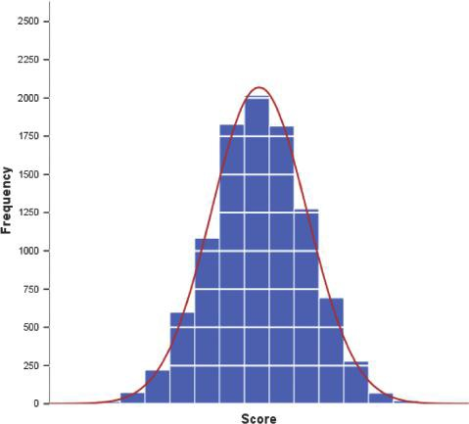
A "normal" distribution (the curve shows the idealized shape)

Slide 23
A positively skewed distribution
A negatively skewed distribution

Slide 24
Statistical Concepts
PART 3
Mean
Medium
Mode
The average of all scores/number
Central tendency
The middle score when scores are ranked from the lowest to the highest
the score that occurs most frequently

Slide 25
Statistical Concepts
PART 3
Precision of Measurement
Variable | mode | median | mean
nominal | + | - | -
ordinal | + | + | -
interval | + | + | +

Slide 26
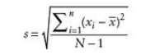
Statistical Concepts
PART 3
Standard deviation
Most widely used measure of variability for variables with an interval level of measurement
Roughly: Average distance of scores from the mean
Calculation:

Slide 27
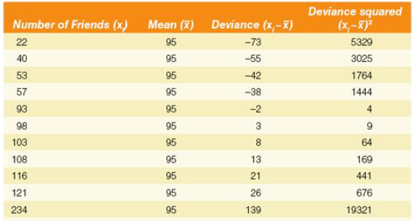

Statistical Concepts
PART 3
The number of friends on WeChat

Slide 28
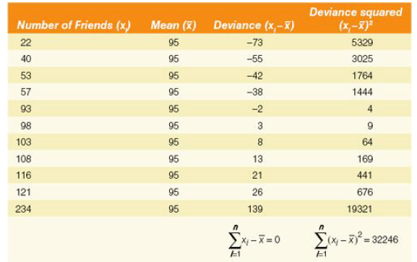
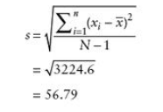
Statistical Concepts
PART 3

Slide 29
A large SD: A heterogeneous sample
A small SD: A homogenous sample

Slide 30
The same mean (2.6 out of 5) but different SDs (0.55 for L1 and 1.82 for L2)

Slide 31
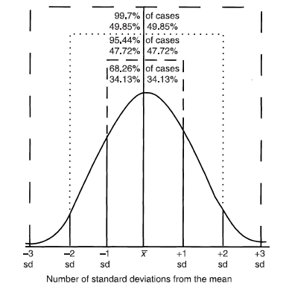
Statistical Concepts
PART 3
Standard deviation & normal distribution

Slide 32
Statistical Concepts
PART 3
Using standard deviations
76 (of 100)
82 (of 100)
Speaking
Writing
Who performed better?

Slide 33
Statistical Concepts
PART 3
Z-scores
A Z-score quantifies the original score in terms of the number of standard deviations that that score is from the mean of the distribution.
Z-score = (score-mean)/standard deviation
Score = 50, mean = 58, SD 10
Z-score = (50-58)/10 = -0.8

Slide 34
Statistical Concepts
PART 3
Using standard deviations
76 (of 100)
82 (of 100)
Speaking
Writing
The mean mark in the speaking class was 54 and the SD was 20, while the mean mark in the writing class was 72 and the SD was 15.
Who performed better?
Notes:
The girl’s Z score is (76-54)/20 = 1.1.
The Boy’s Z score is (82-72)/15 = 0.67.

Slide 35
04
PART FOUR
Getting Started!

Slide 36
Getting Started
PART 4
Create & save a data file
Explore
SPSS in Use
Enter & edit data
Descriptives
Save & print output
Frequencies

Slide 37

01
Create and save a data file
02
Enter and edit data

Slide 38
Getting Started
PART 4
01
02
Frequencies
Descriptives
03
04
Save & Print Output
Explore

Slide 39

Getting Started
PART 4
01
Frequencies

Slide 40
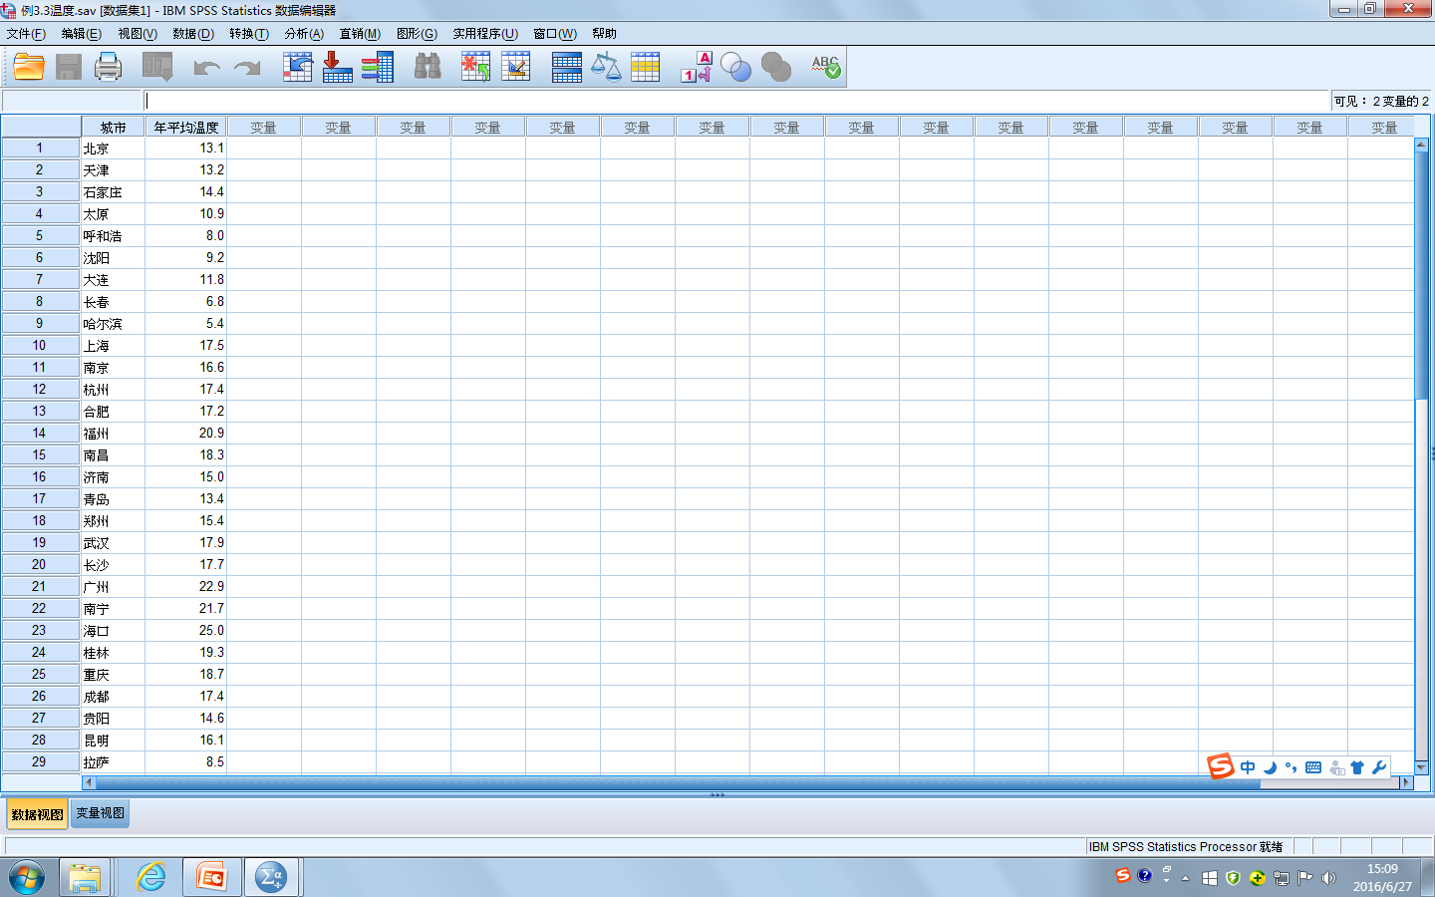

Slide 41
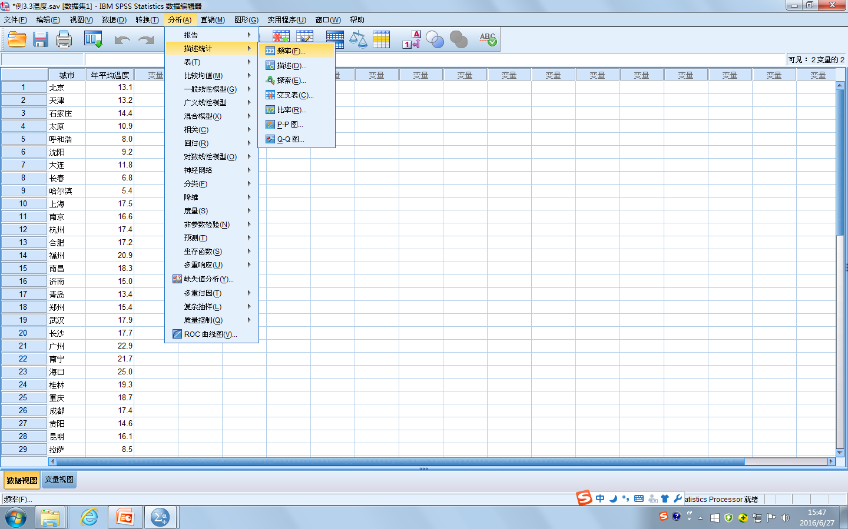

Slide 42
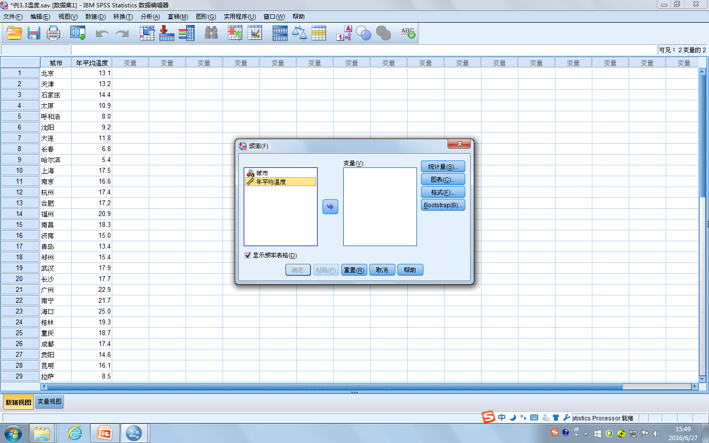

Slide 43
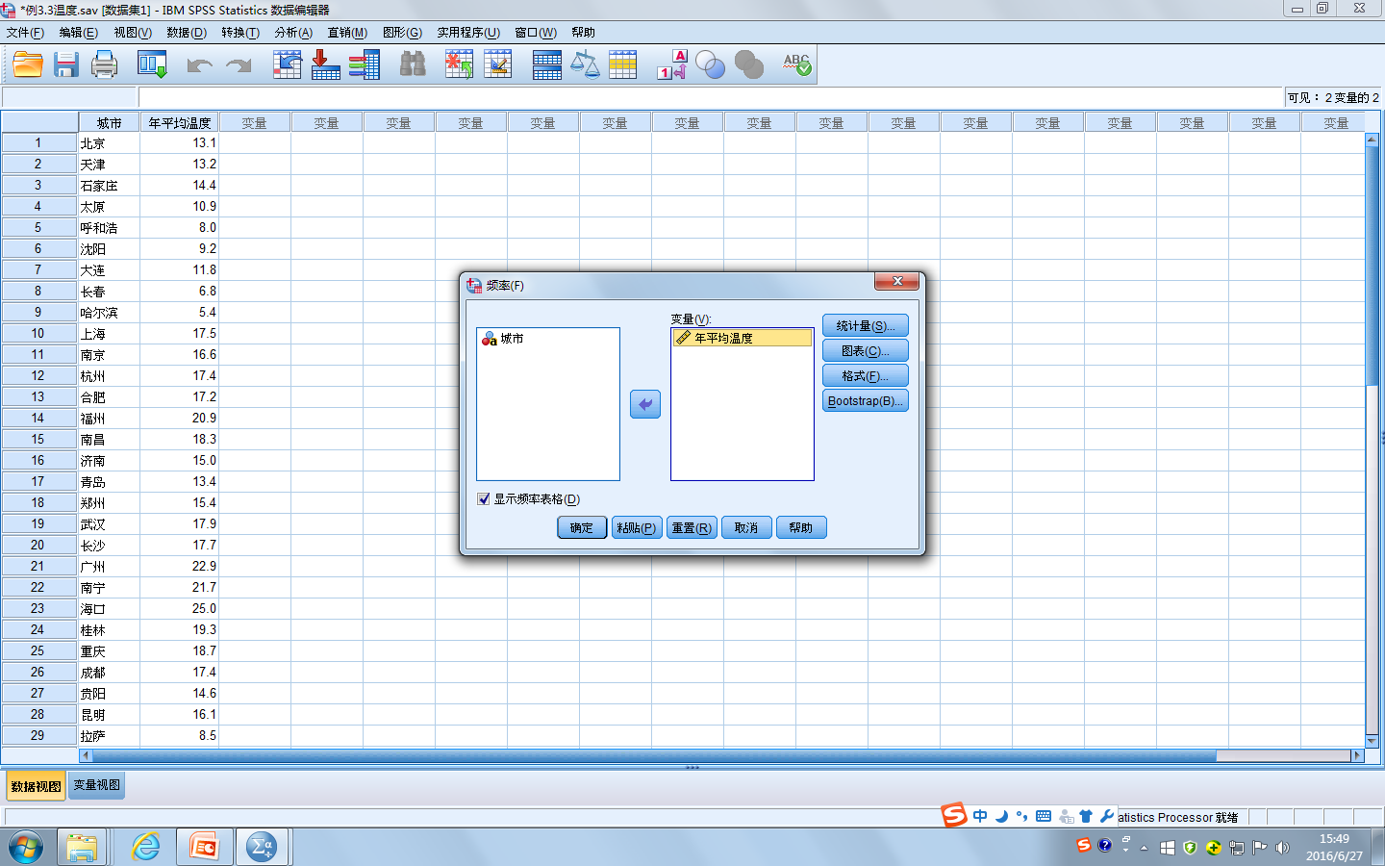

Slide 44
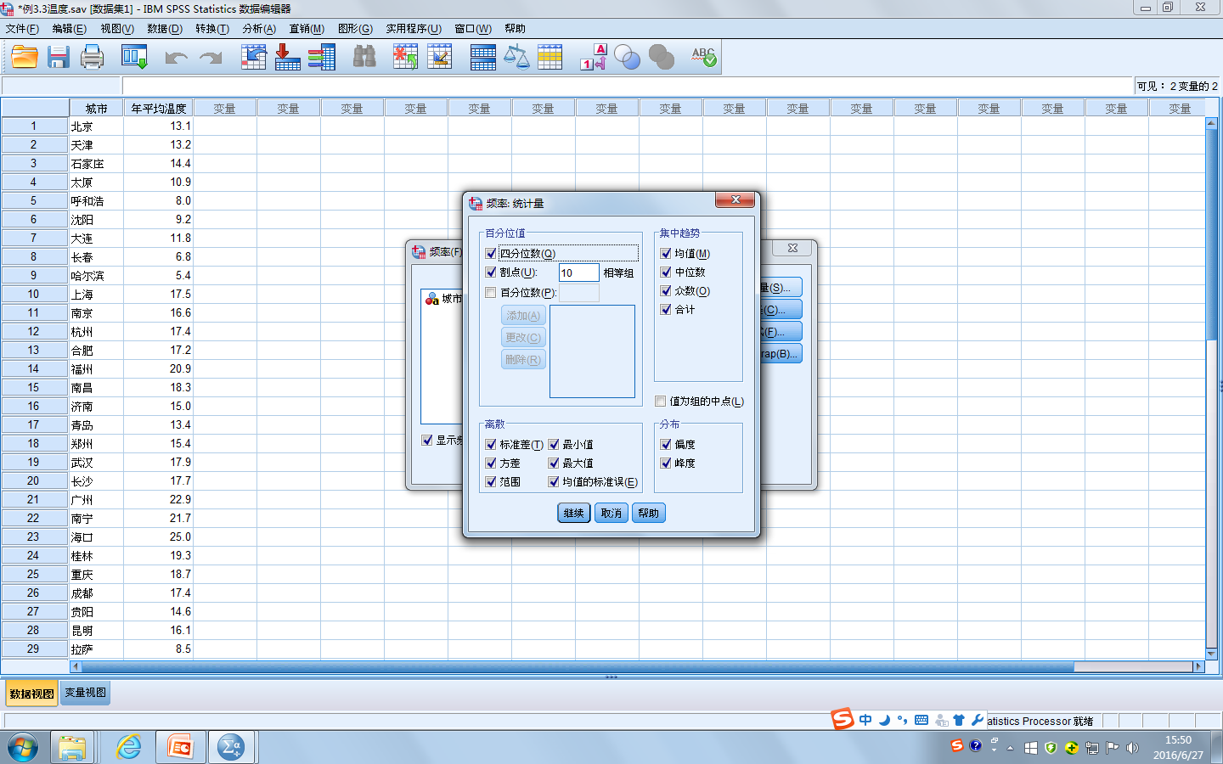

Slide 45


Slide 46
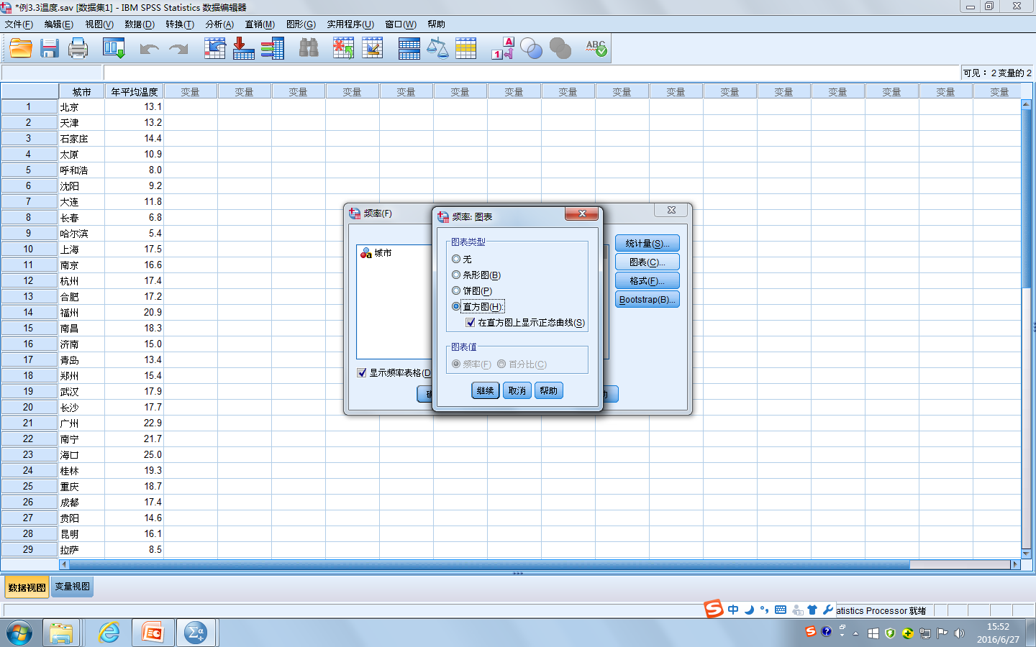

Slide 48
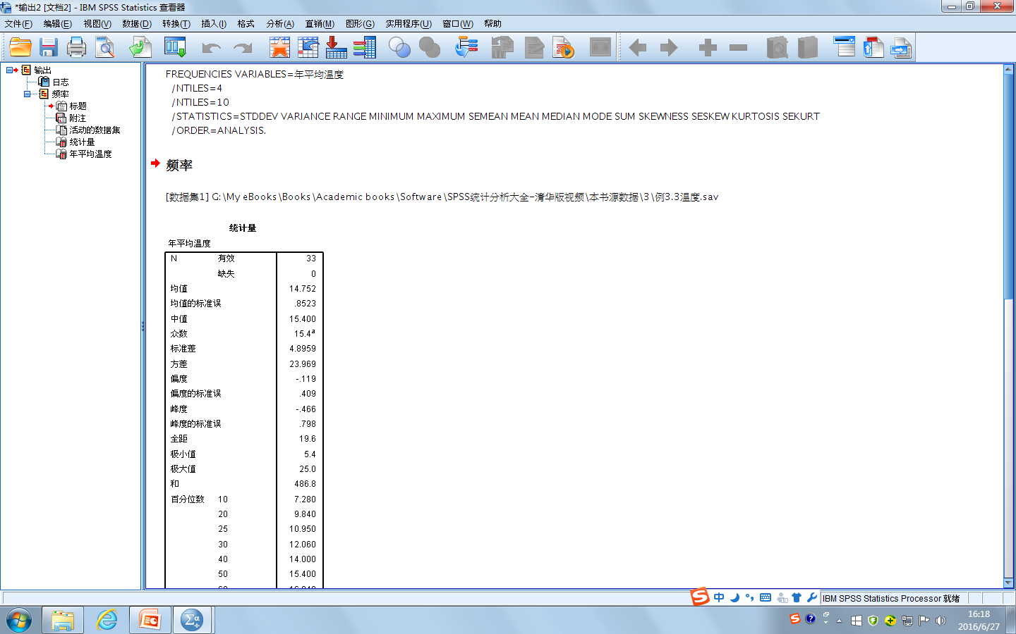

Slide 49
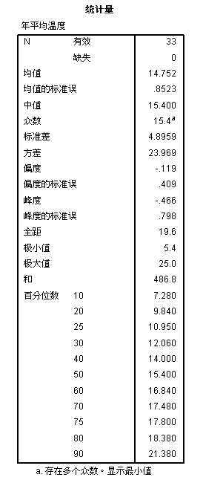
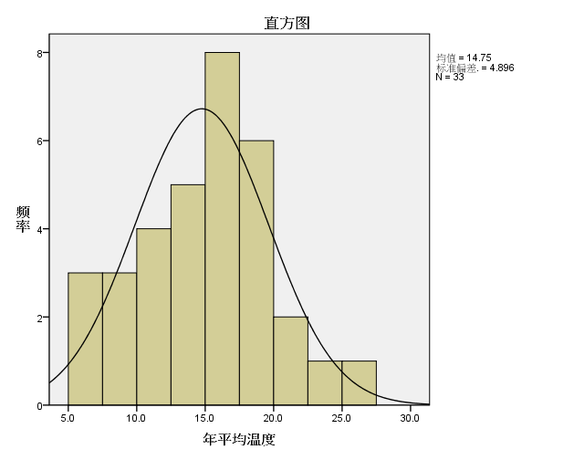

Slide 50
Getting Started
PART 4
02
Descriptives

Slide 52


Slide 53
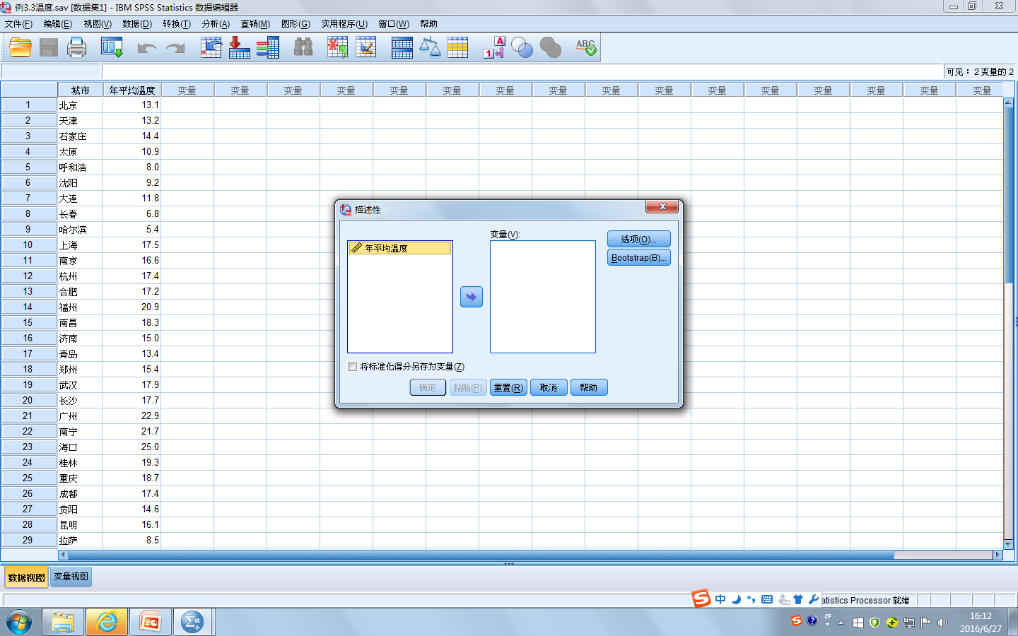

Slide 54
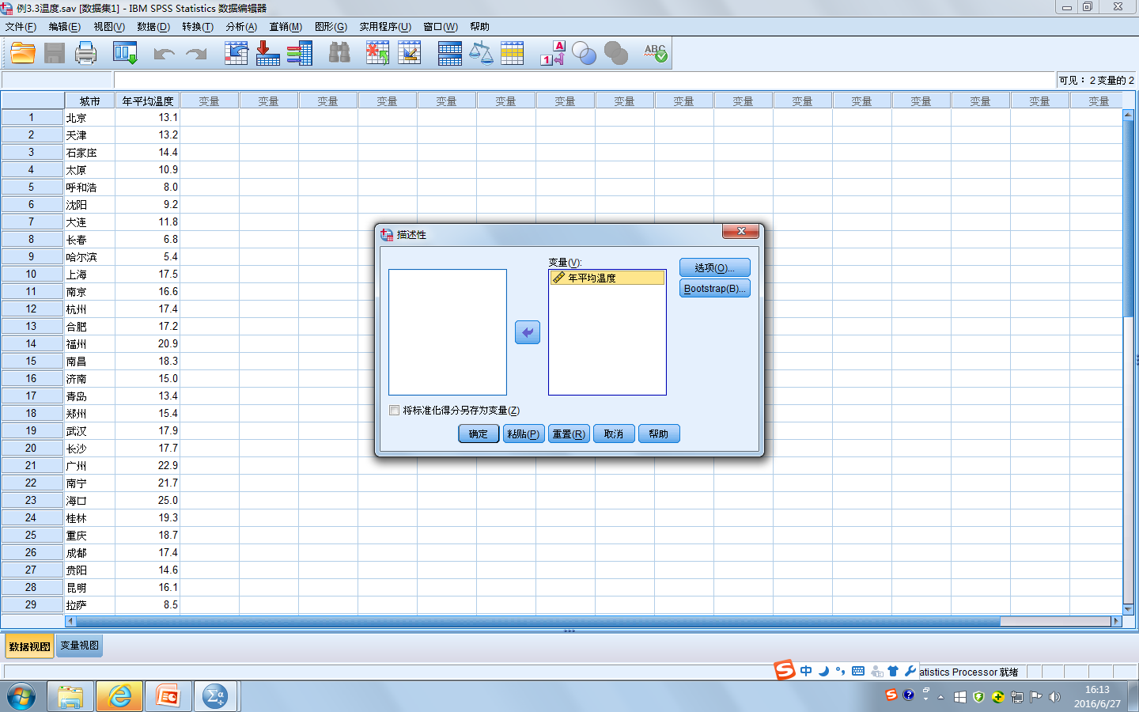

Slide 55


Slide 56


Slide 57
Getting Started
PART 4
03
Explore

Slide 59
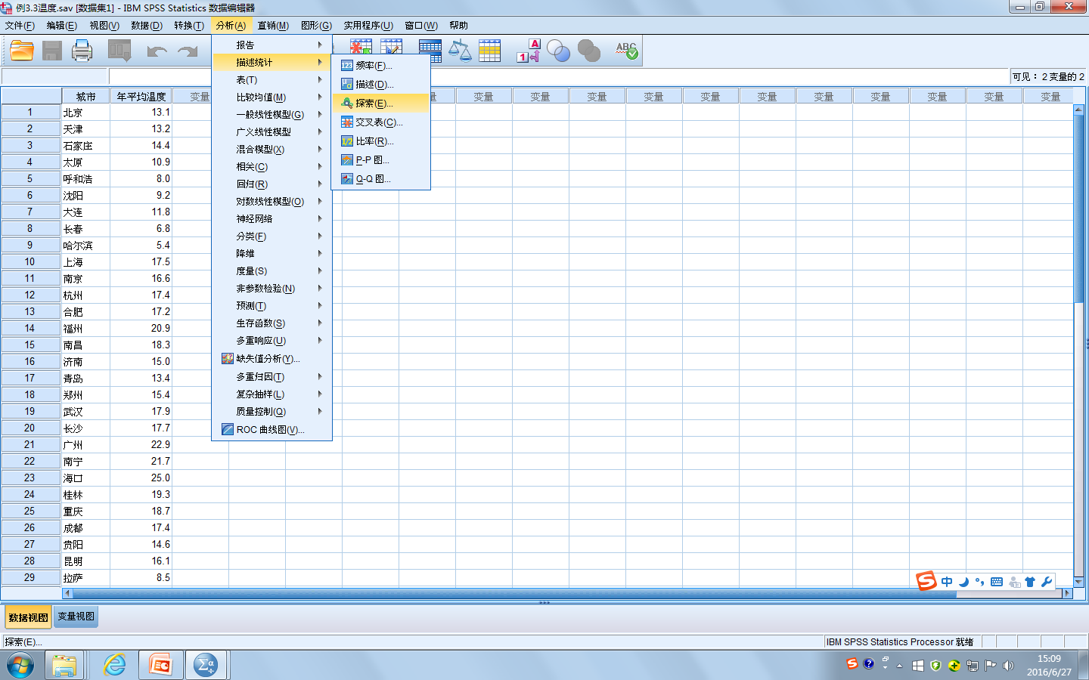

Slide 60
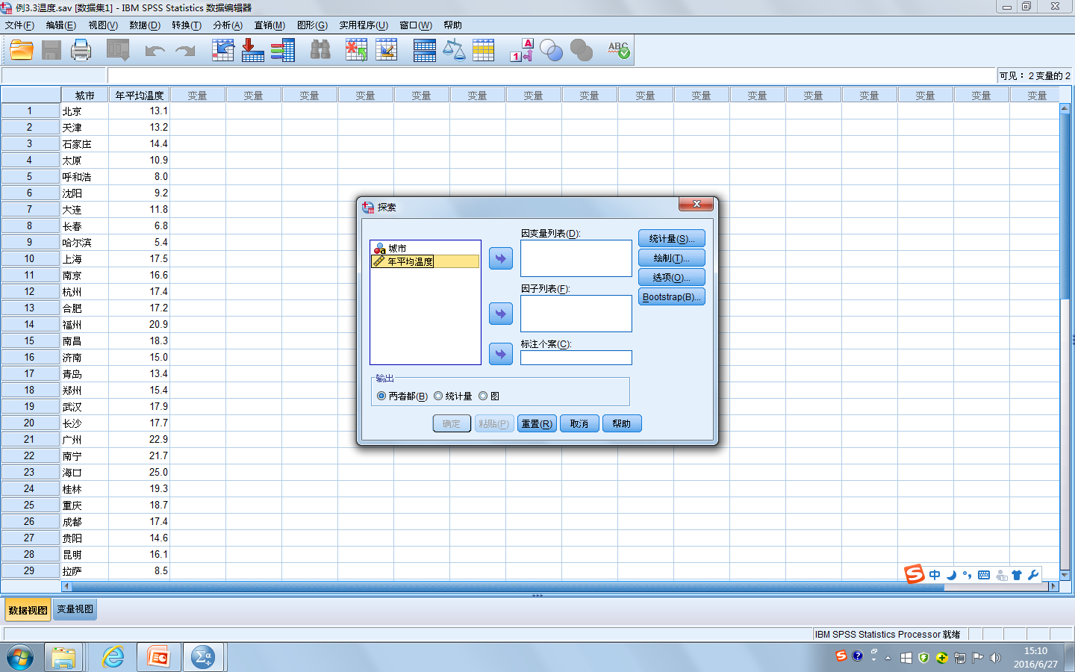

Slide 61
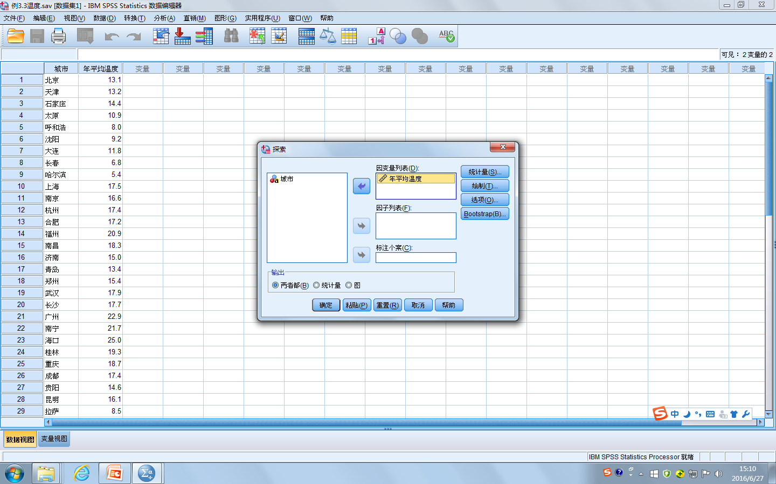

Slide 62
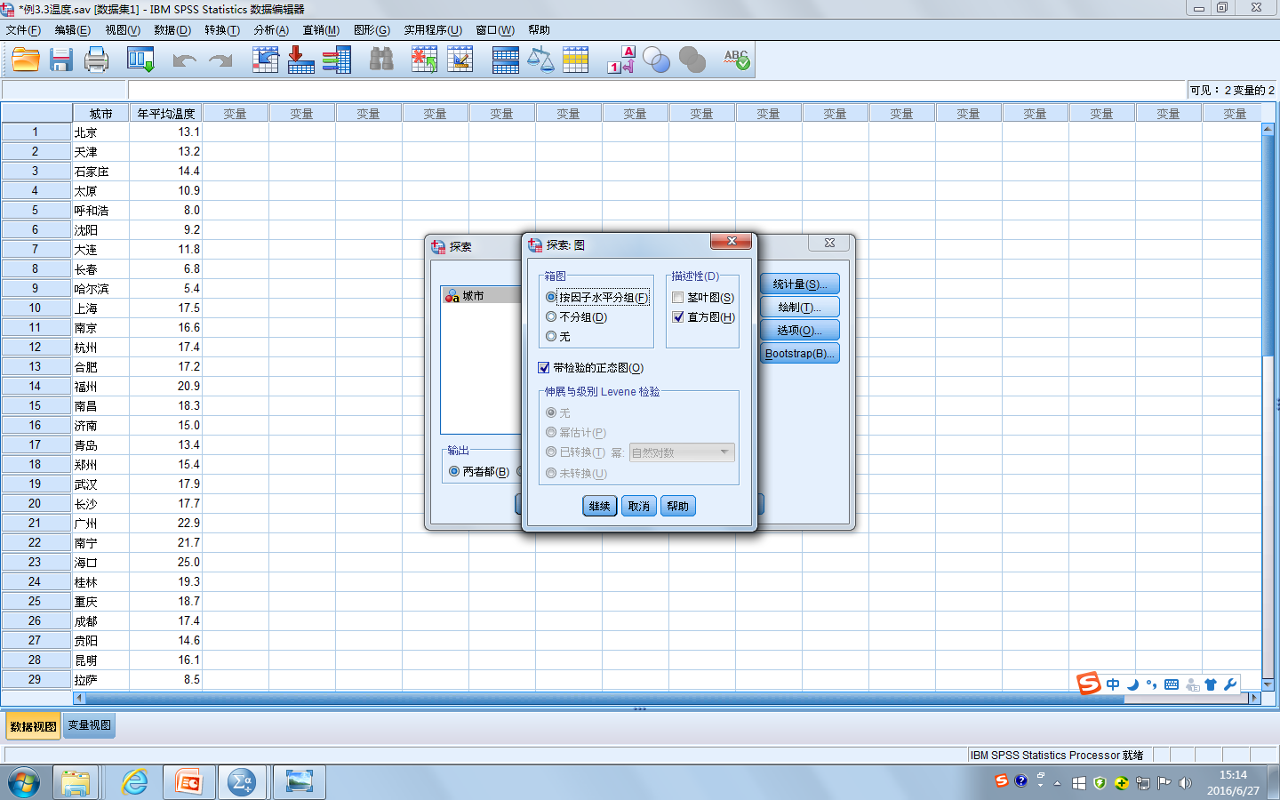

Slide 64
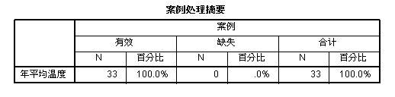

Slide 65
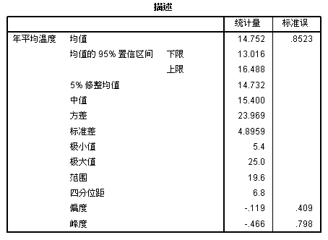

Slide 66
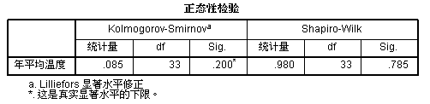
Use the Shapiro-Wilk test if the sample size is 3-2,000.
Use the Kolmogorov-Smirnov test if the sample size is more than 2,000.
If the test result is significant (the p value＜0.05), the data is NOT normally distributed. If the test result is not significant (the p value＞0.05), the data is normally distributed.

Slide 67
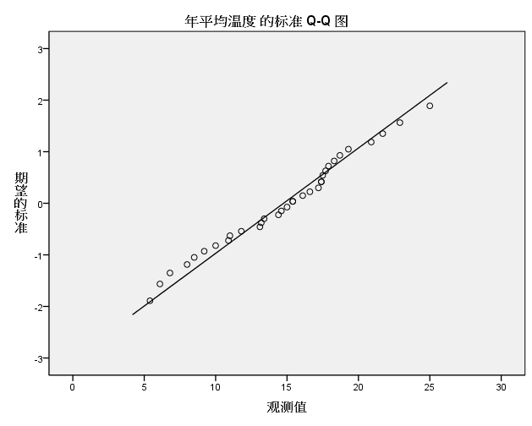
The Q-Q Plot

Slide 68
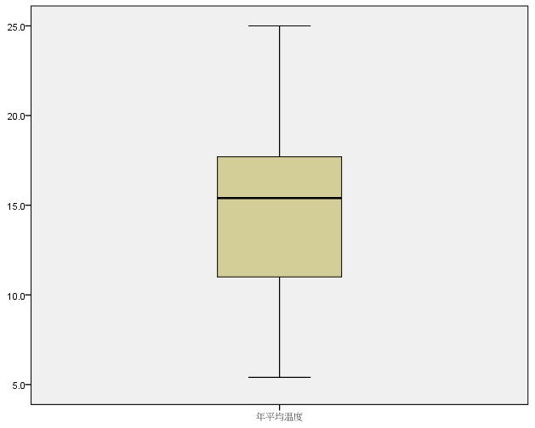
The Box Plot

Slide 69
Getting Started
PART 4
04
Save & Print Output

Slide 71
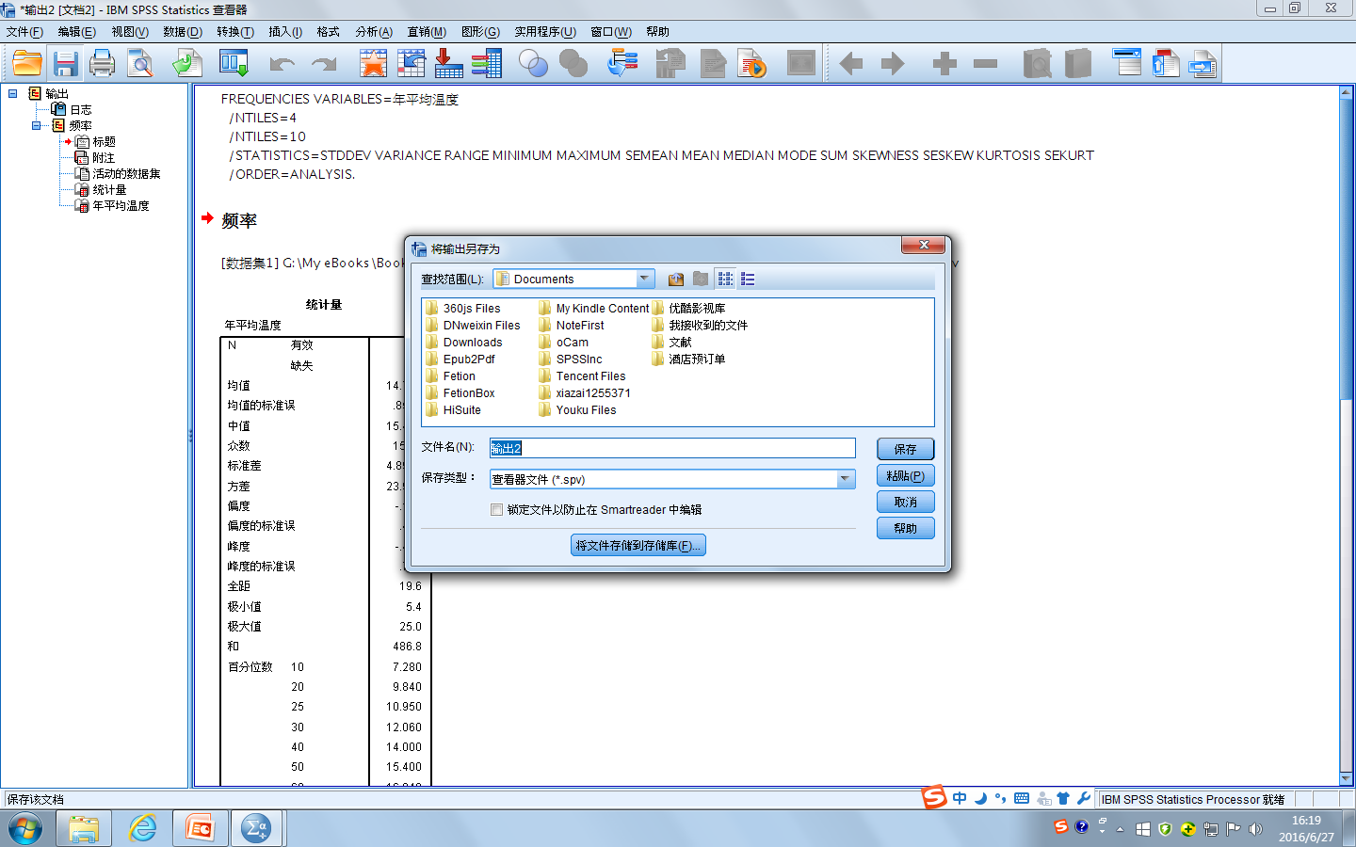

Slide 72
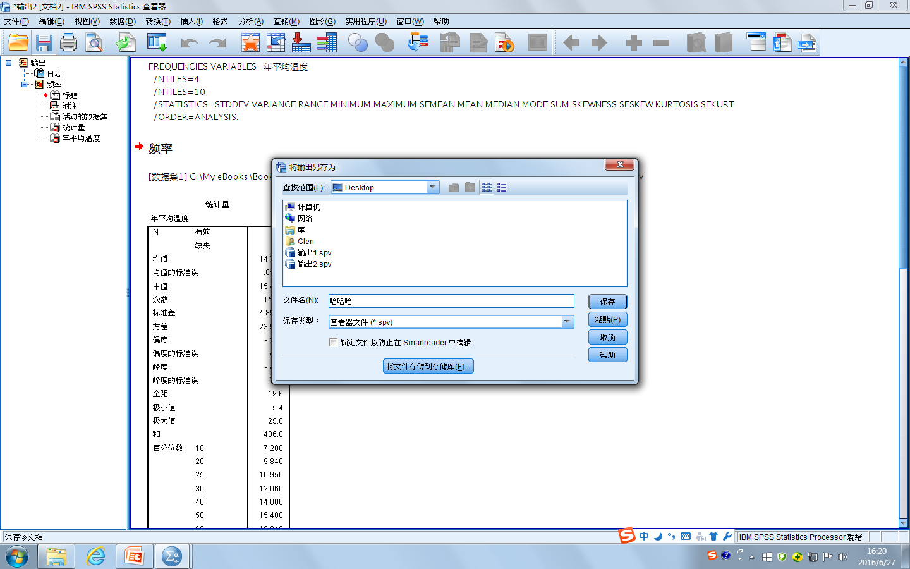

Slide 73
Assignments
Create an SPSS data file entitled “The Final Grades for Basic Writing II_2020”.
Enter the raw data from the excel file entitled “Assignment 1_2020” and present the opened file in a screenshot.
Use SPSS to calculate the mean, mode, and median (together with the output）.
Use SPSS to convert the grades to Z-scores, which are shown in a screenshot.
Use SPSS to produce the histogram , Q-Q plot and box plot for the distribution of the grades and tell whether the grades are normally distributed based on the diagrams.
Use SPSS to run the normality test to tell whether the grades are normally distributed and provide the reason.

Slide 74
References
Field, A. (2009). Discovering statistics using SPSS (3rd ed.).
London: Sage Publications Ltd.
武松、潘发明等.(2014) .SPSS统计分析大全.北京:清华大学
出版社.
许宏晨.(2013) .第二语言研究中的统计案例分析.北京：外
语教学与研究出版社.

Slide 75
THANKS

